Slide 1
Money and Interest
Rajiv Sethi and the CORE Team
November 15, 2021

Slide 2
Overview
What is money?
Choices involving time
Borrowing and lending
Preferences, constraints, and choice
Consumption smoothing
Debt markets
Reading: The Economy Unit 10 Introduction, 10.1 to 10.5

Slide 3
Money

Slide 4
What is Money?
Money includes currency (bills and coins) but is more than this
Money also includes bank deposits that can be used to make transactions
It is accepted in exchange for goods and services of all kinds
Which makes money a medium of exchange
Debit card payments transfer money from buyer to seller account
Credit card payments transfer money from card issuer to seller account
When you pay off card, you transfer money from your account to issuer
Borrowing gets you money now with obligation to pay back later
Borrowing and lending allows people to transfer expenditure across time

Slide 5
Choices Involving Time

Slide 6
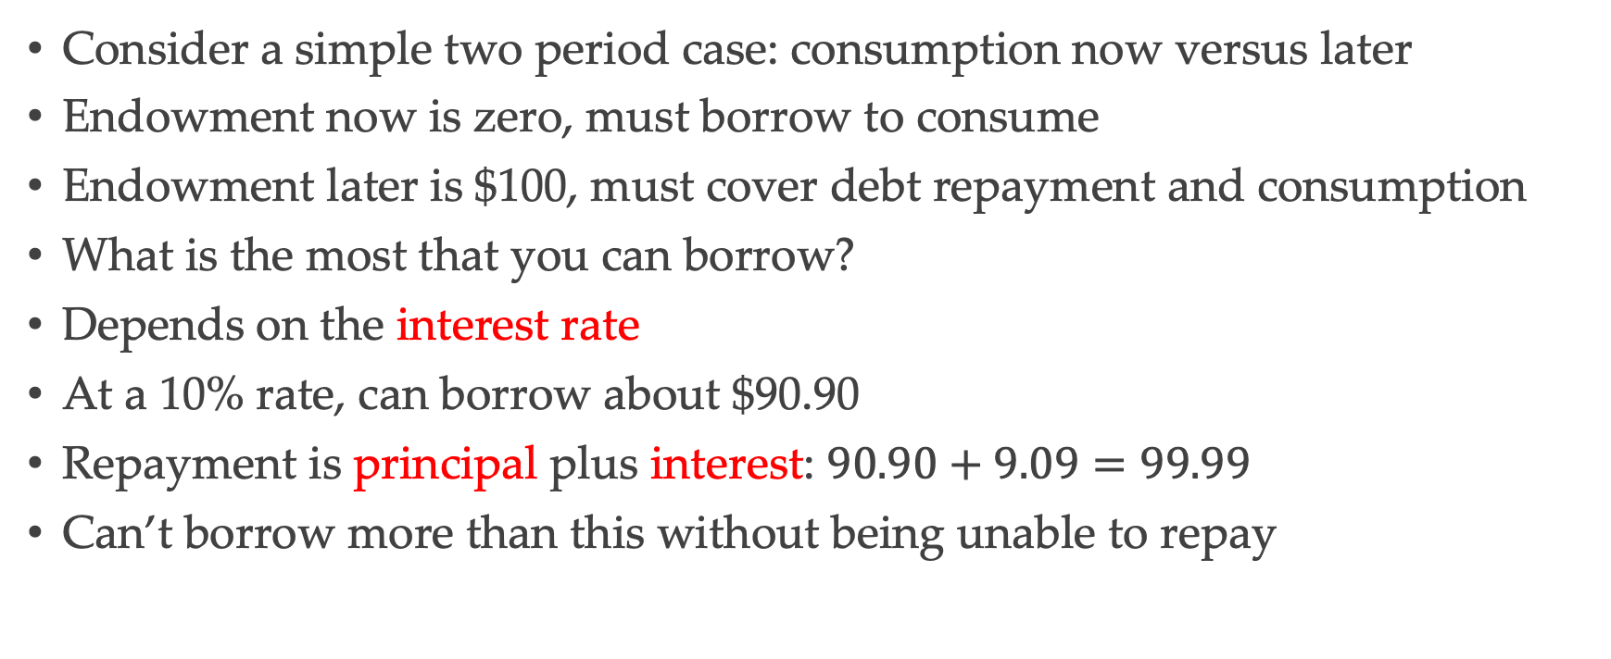
Borrowing
Consider a simple two period case: consumption now versus later
Endowment now is zero, must borrow to consume
Endowment later is $100, must cover debt repayment and consumption
What is the most that you can borrow?
Depends on the interest rate
At a 10% rate, can borrow about $90.90
Repayment is principal plus interest: $90.90+9.09=99.99$
Can’t borrow more than this without being unable to repay

Slide 7
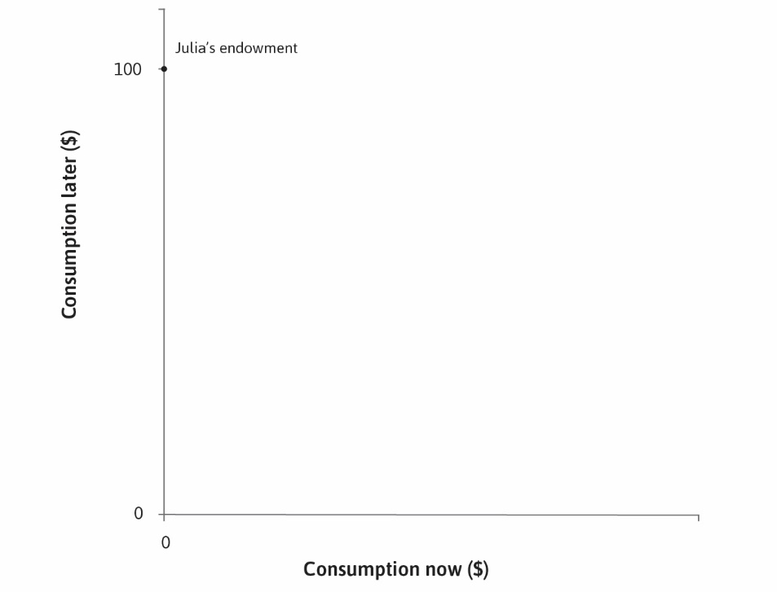

Slide 8


Slide 9
Feasible Frontier
Borrowing can be any amount less than the maximum
Example: borrow $70
Repayment is $77 so later consumption is $23
So consuming $70 now and $23 later is feasible
What if I consume $30 now, how much can I consume later?
The feasible frontier in this case is a straight line
Sometimes called the intertemporal budget constraint
What is the slope of this line?

Slide 10
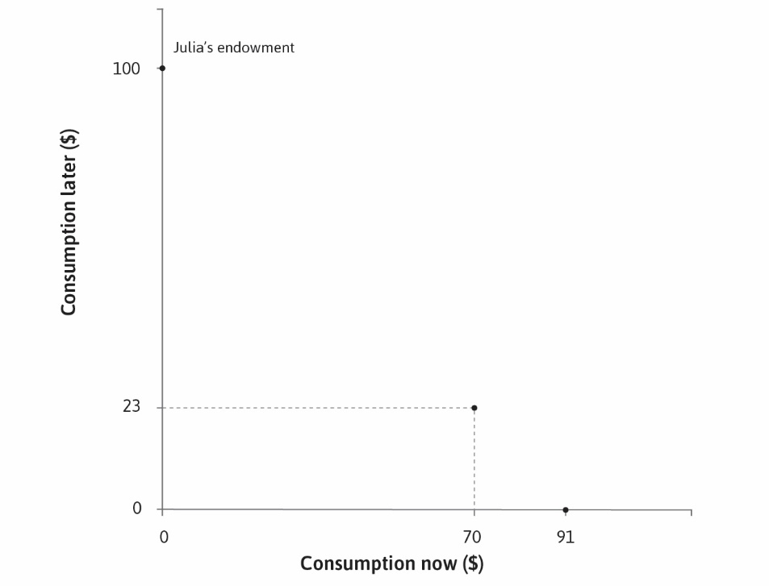

Slide 11


Slide 12
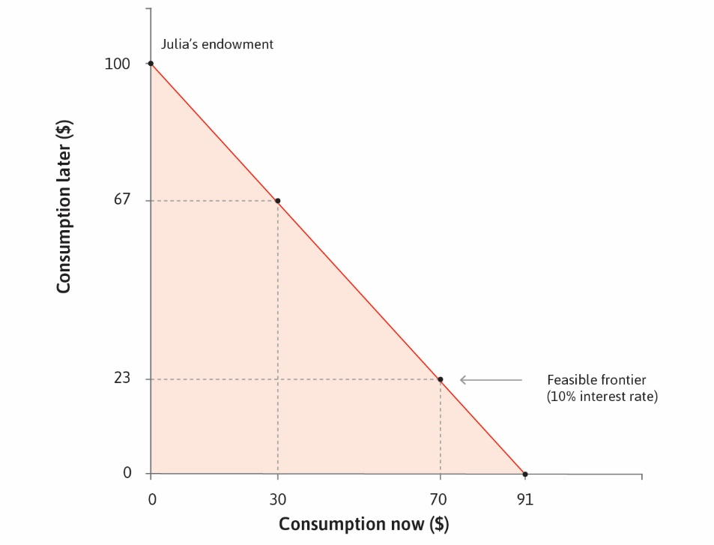

Slide 13


Slide 14
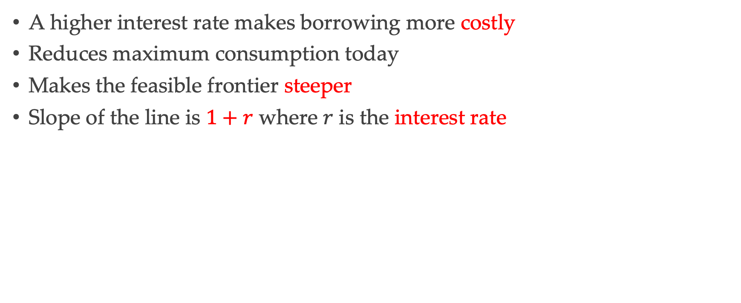
Changes in the Interest Rate
A higher interest rate makes borrowing more costly
Reduces maximum consumption today
Makes the feasible frontier steeper
Slope of the line is $1+r$ where $r$ is the interest rate

Slide 15
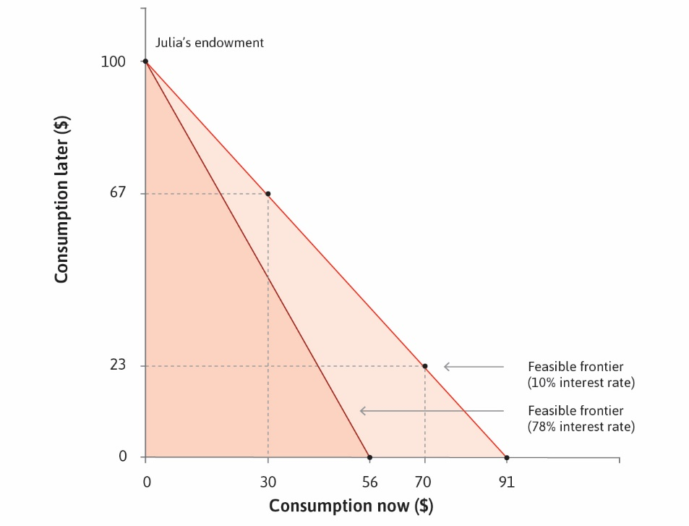

Slide 16


Slide 18
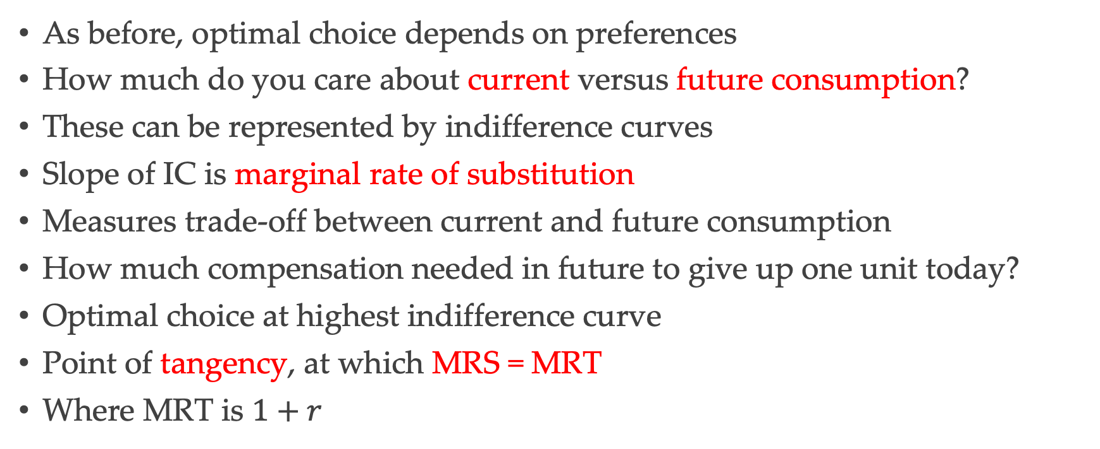
Preferences and Choice
As before, optimal choice depends on preferences
How much do you care about current versus future consumption?
These can be represented by indifference curves
Slope of IC is marginal rate of substitution
Measures trade-off between current and future consumption
How much compensation needed in future to give up one unit today?
Optimal choice at highest indifference curve
Point of tangency, at which MRS = MRT
Where MRT is $1+r$

Slide 19
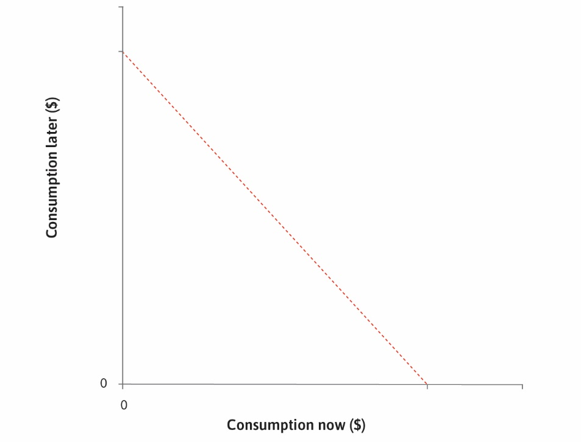

Slide 20
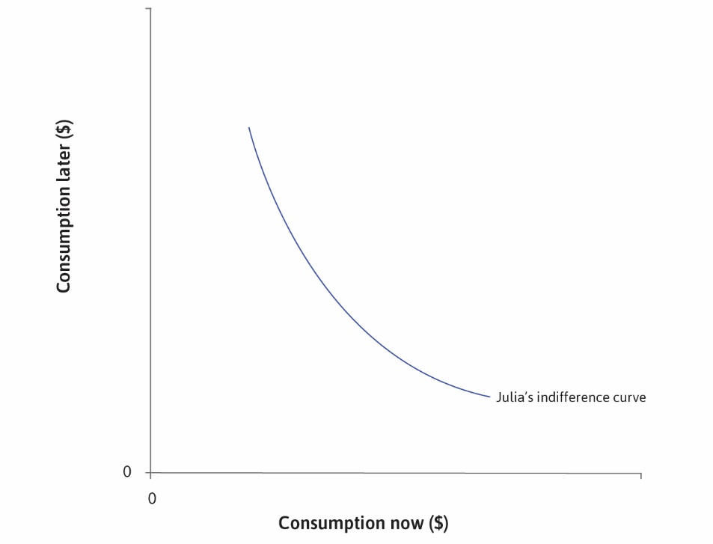

Slide 21
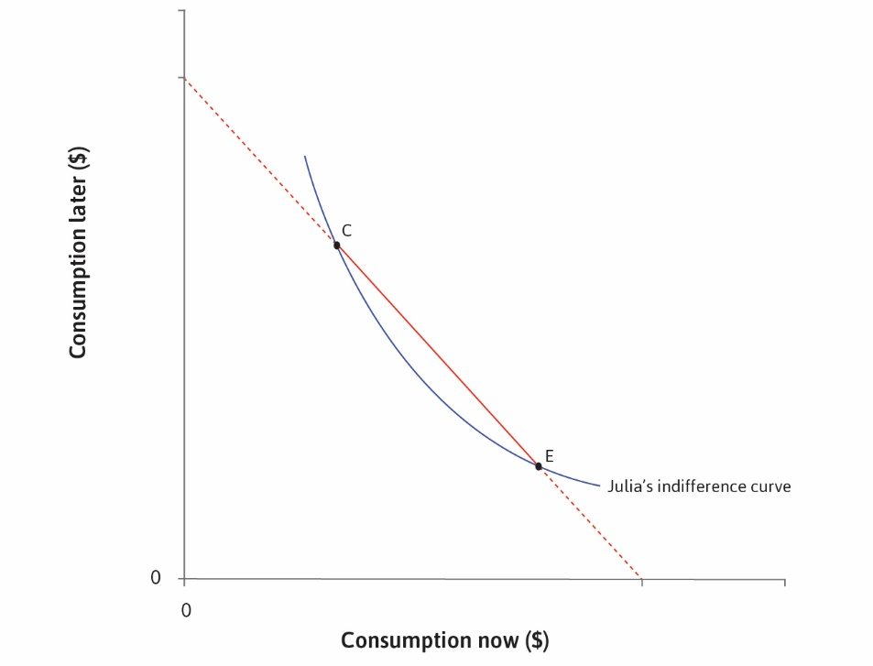

Slide 22
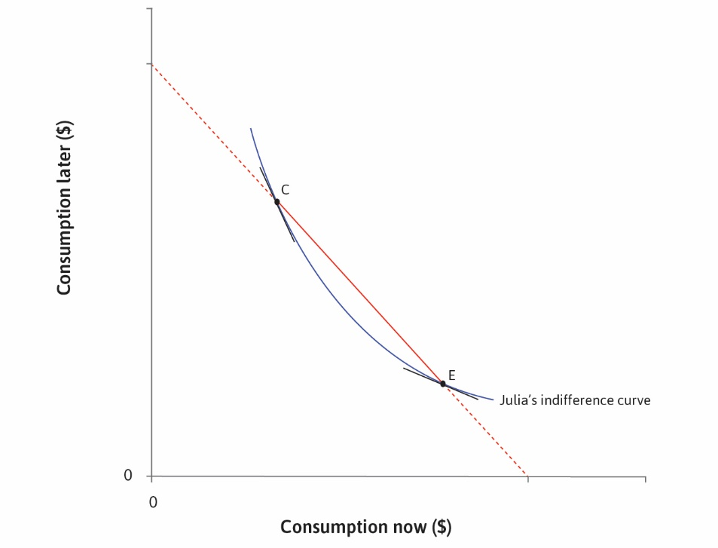

Slide 23
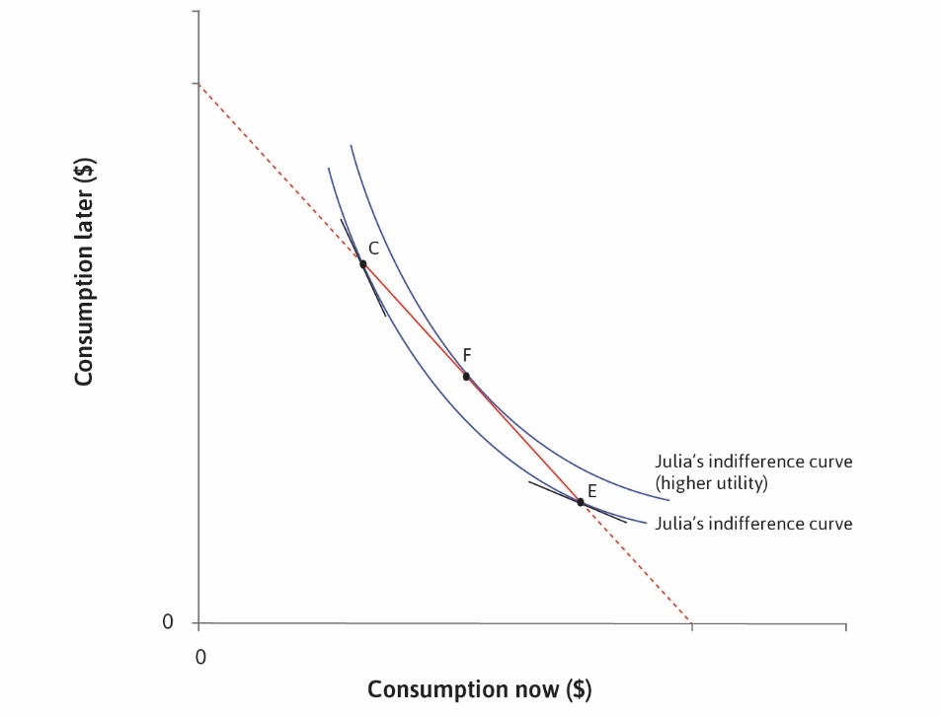

Slide 24
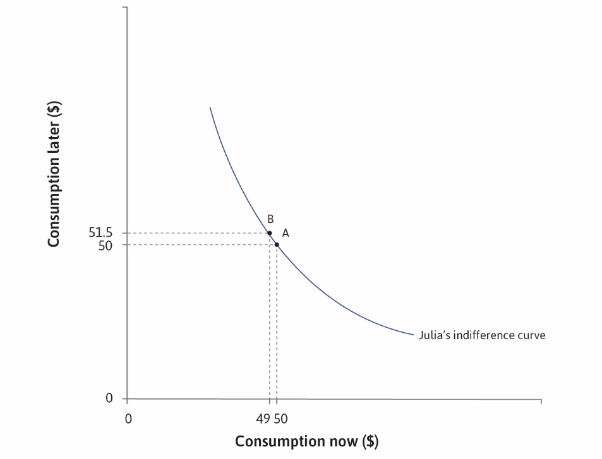

Slide 25
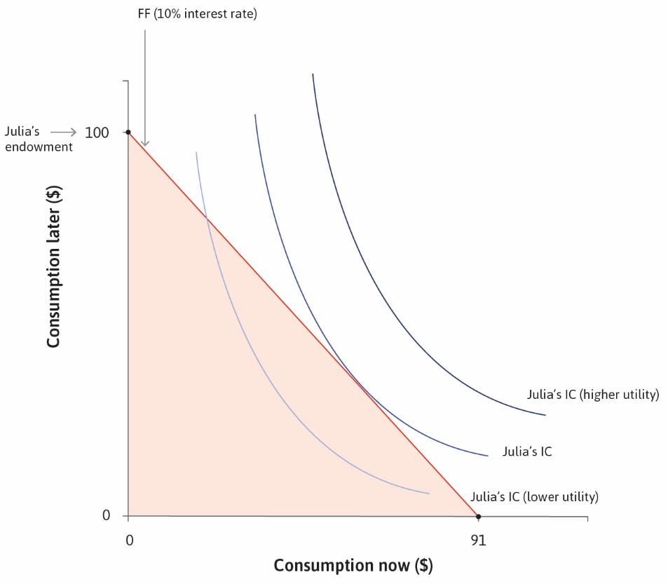

Slide 26
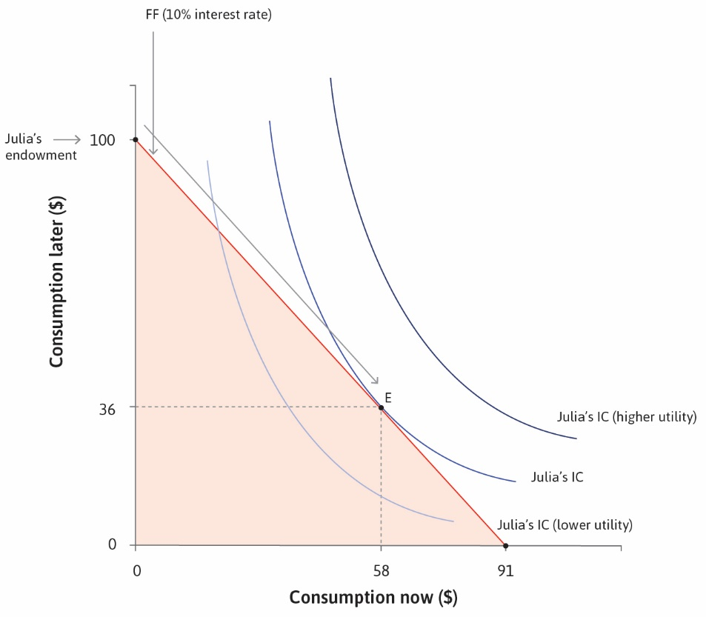

Slide 27
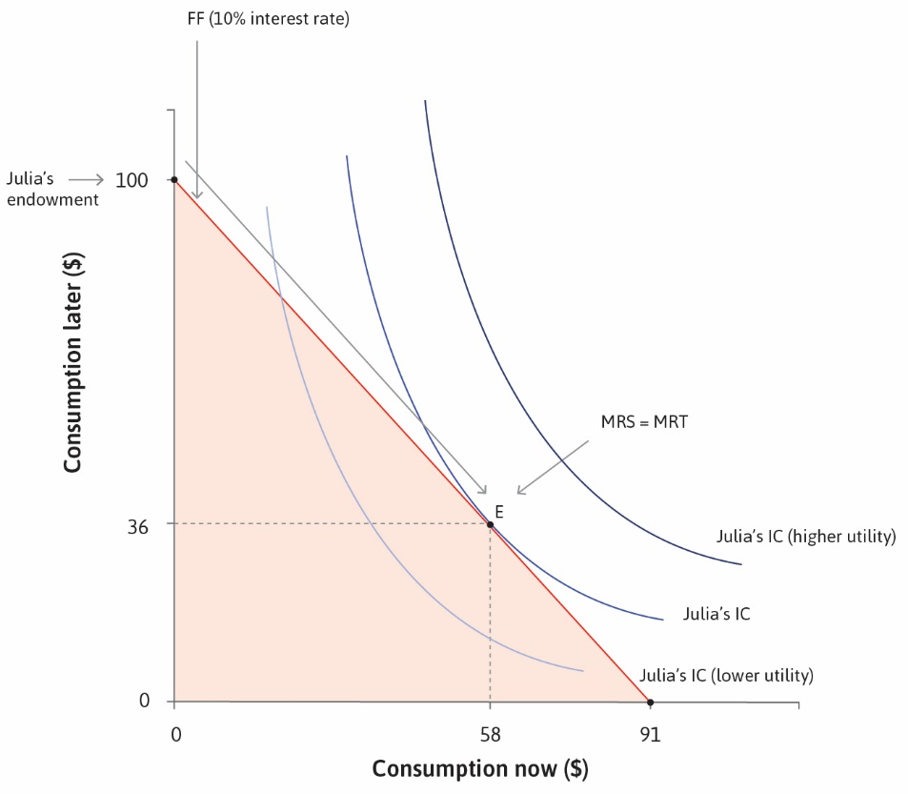

Slide 28
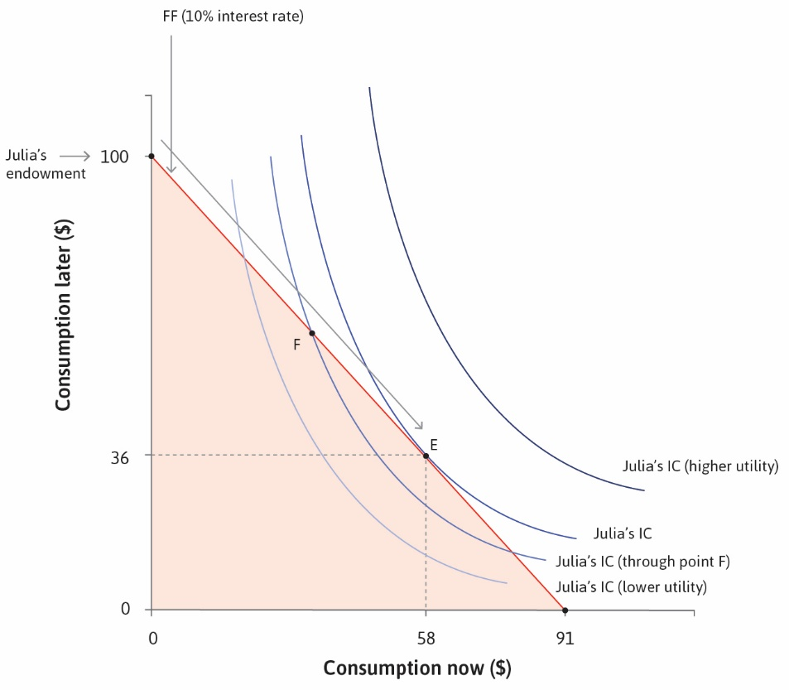

Slide 29
Changes in Interest Rate
Change in interest rate will change consumption and borrowing
Higher interest rate will tend to reduce borrowing (substitution effect)
But higher interest rate means lower income (current endowment is zero)
So there is also an income effect
Current consumption will decline
Future consumption depends on relative strength of two effects

Slide 30
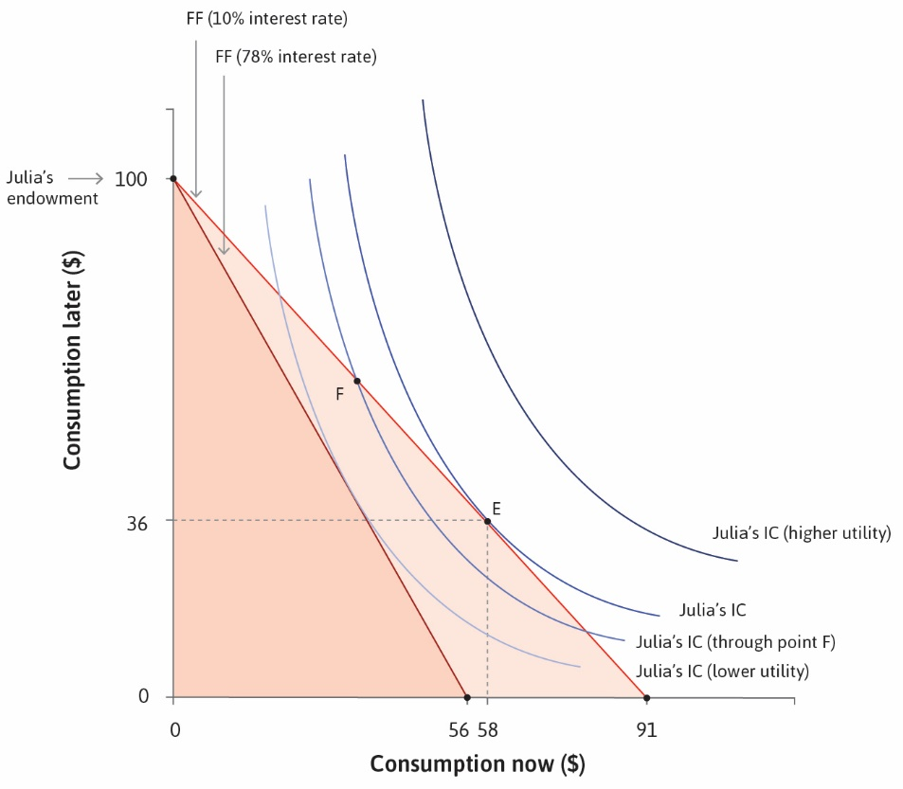

Slide 31
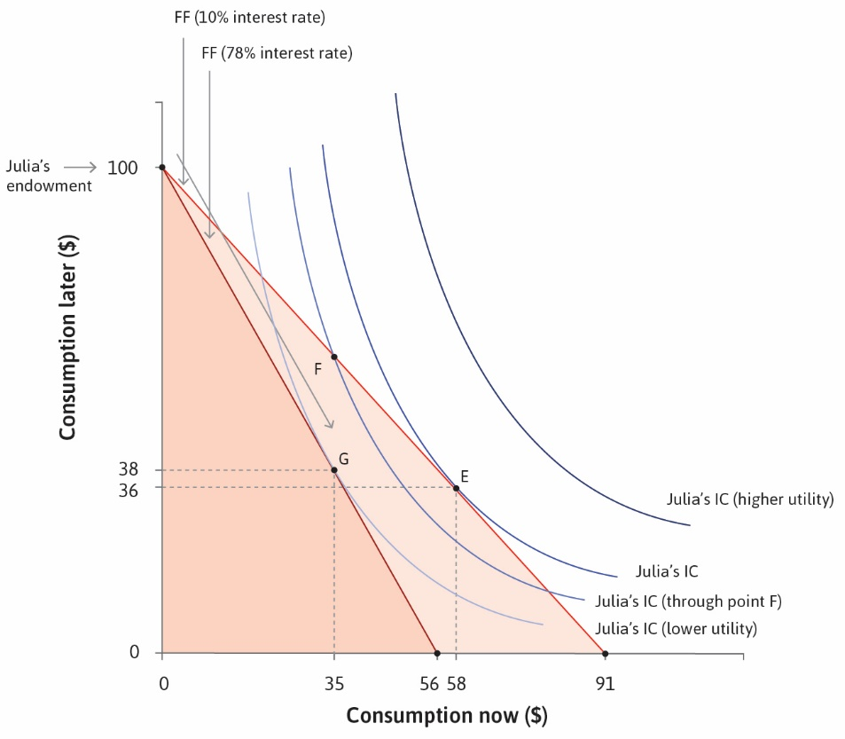

Slide 32
Lending
Lenders have more income now, less in the future
Would like to save or lend rather than borrow
Example: $100 today, could spend today or save for future
Case A: Interest rate is –20% (think of fees or storage/ insurance costs)
Case B: Interest rate is 10% (as in earlier case)
How do consumption choices (current and future) change?
Can we decompose the change into income and substitution effects?

Slide 33
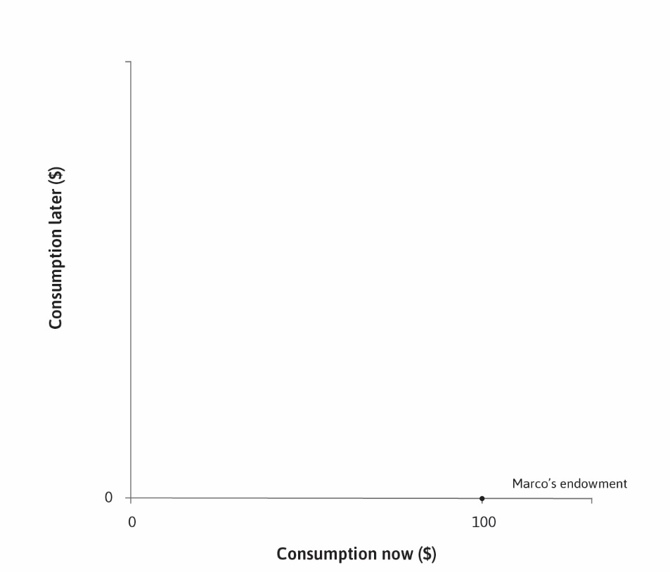

Slide 34
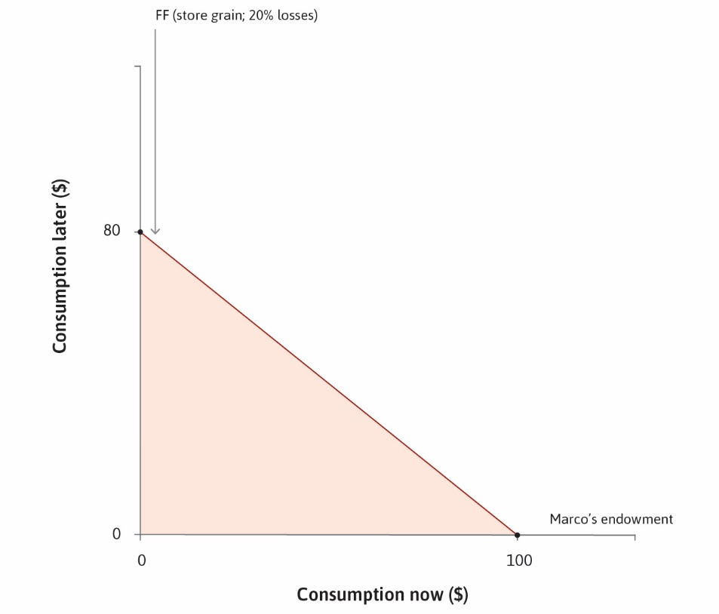

Slide 35
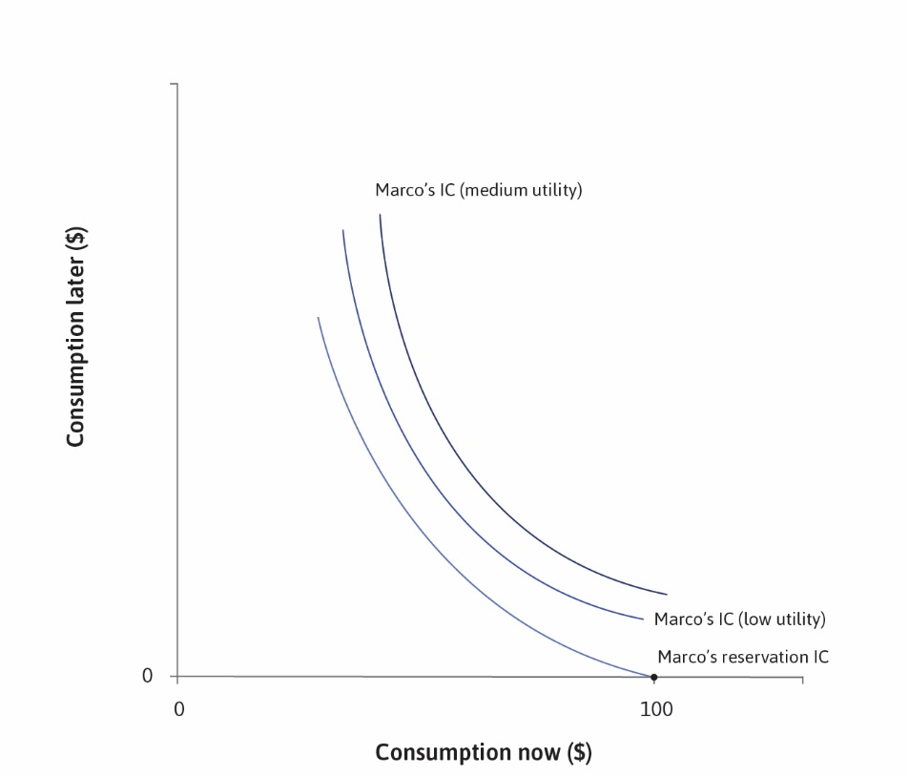

Slide 36
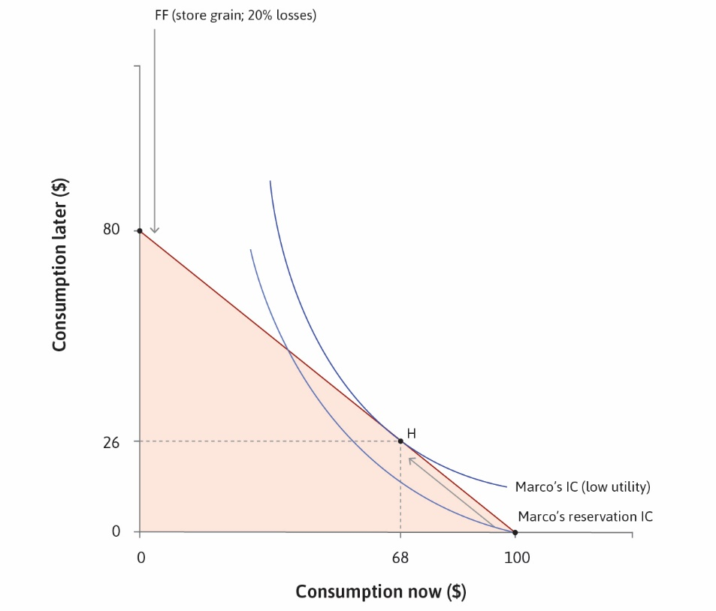

Slide 37
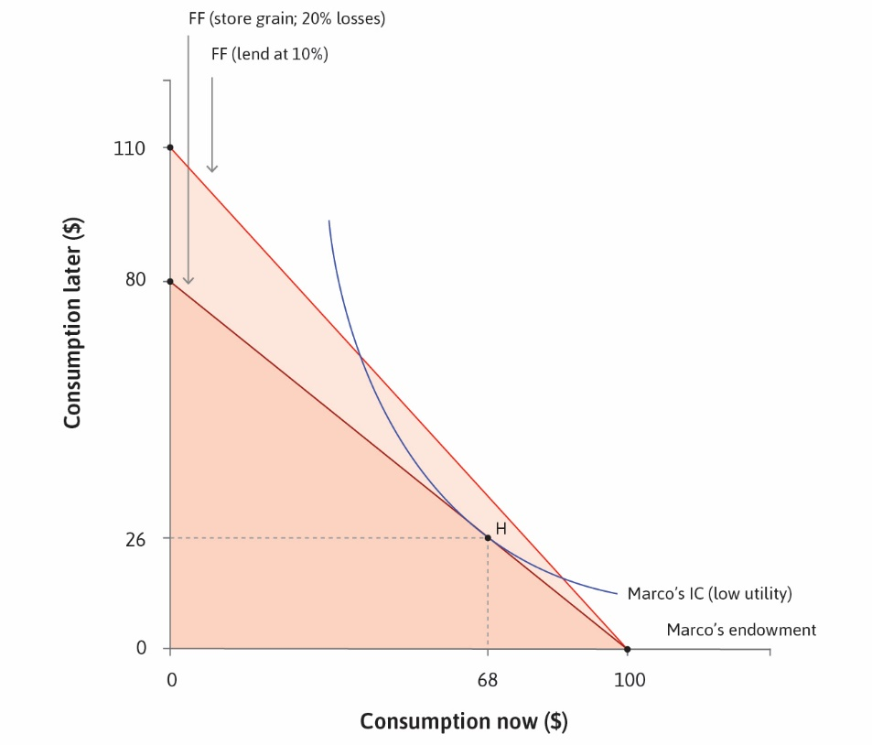

Slide 38
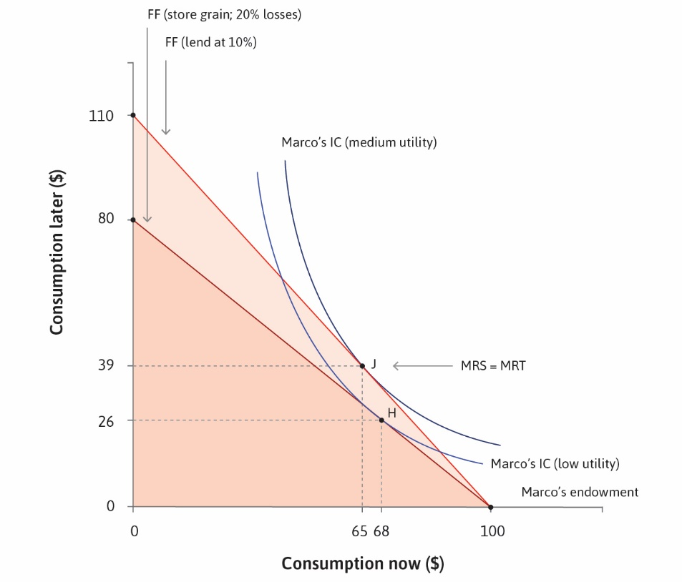

Slide 39
Equilibrium Interest Rate
At any given any interest rate, some will want to borrow and some lend
Total demand for borrowing may not match supply from lenders
Interest rate will adjust in response to demand-supply imbalance
At equilibrium interest rate, demand and supply are equalized
But we need to also consider expectations of inflation
Distinction between nominal and real interest rates
And central bank interest rate policy

